Slide 1
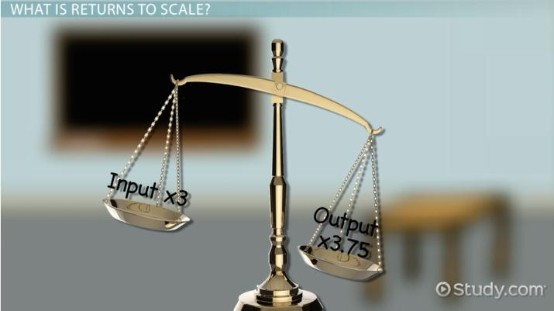

Slide 2
Law of Returns to Scale
In the long run all factors of production are variable. No factor is fixed. Accordingly, the scale of production can be changed by changing the quantity of all factors of production.
Definition:
“The term returns to scale refers to the changes in output as all factors change by the same proportion.” Koutsoyiannis
“Returns to scale relates to the behaviour of total output as all inputs are varied and is a long run concept”. Leibhafsky

Slide 3
Returns to scale are of the following three types:
1. Increasing Returns to scale.
2. Constant Returns to Scale.
3.Diminishing Returns to Scale.
In the long run, output can be increased by increasing all factors in the same proportion.
Generally, laws of returns to scale refer to an increase in output due to increase in all factors in the same proportion. Such an increase is called returns to scale.

Slide 4
Assumptions of the Law
This law is applicable in long run.
All factors of production are assumed to vary & in equal proportion.
Technology is assumed to remain constant.
Only physical inputs & output is considered.

Slide 5
Land in Acres | Labour | Combination | TP | MP | Scales
5 | 1 | 5+1 | 10 | 10
10 | 2 | 10+2 | 30 | 20 | Increasing
15 | 3 | 15+3 | 60 | 30
20 | 4 | 20+4 | 90 | 30 | Constant
25 | 5 | 25+5 | 120 | 30
30 | 6 | 30+6 | 140 | 20 | Diminishing
35 | 7 | 35+7 | 150 | 10

Slide 6
Y axis
Marginal product
Increasing returns to scale
Constant returns to scale
Diminishing returns to scale
MP
scale of inputs
X axis

Slide 7
STAGE 1
STAGE 2
STAGE 3
Laws of increasing returns to scale | Law of constant return to scale | Law of diminishing returns to scale
When all the inputs are increased & output increase is more than the increase in the input. | When the input output increases in the same proportion , the returns are constant. | When the inputs are increased , but the increase in the output is less than the increase in input.

Slide 8
Economies of Scale

Slide 9
Economies of Scale
The advantages of large scale production that result in lower unit (average) costs (cost per unit)
AC = TC / Q
Economies of scale – spreads total costs over a greater range of output

Slide 10
Internal and External Economies
Internal Economies
Those Specifically related to the business itself eg:-
Production
Purchasing
Marketing
Financial
Managerial
External Economies
Benefits the whole industry and not specific firms
Skilled labour in the area
Better road and rail networks
Improves the reputation of the area
Attracts other businesses

Slide 11
Economies of Scale
Internal – advantages that arise as a result of the growth of the firm
Technical
Commercial
Financial
Managerial
Risk Bearing

Slide 12
Economies of Scale
External economies of scale – the advantages firms can gain as a result of the growth of the industry – normally associated with a particular area
Supply of skilled labour
Reputation
Local knowledge and skills
Infrastructure
Training facilities

Slide 13
Economies of Scale
Internal: Technical
Specialisation – large organisations can employ specialised labour
Indivisibility of plant – machines can’t be broken down to do smaller jobs!
Principle of multiples – firms using more than one machine of different capacities - more efficient
Increased dimensions – bigger containers can reduce average cost

Slide 14
Economies of Scale
Indivisibility of Plant:
Not viable to produce products like oil, chemicals on small scale – need large amounts of capital
Agriculture – machinery appropriate for large scale work – combines, etc.

Slide 15
Economies of Scale
Principle of Multiples:
Some production processes need more than one machine
Different capacities
May need more than one machine to be fully efficient

Slide 16
Economies of Scale
Commercial
Large firms can negotiate favourable prices as a result of buying in bulk
Large firms may have advantages in keeping prices higher because of their market power

Slide 17
Economies of Scale
Financial
Large firms able to negotiate cheaper finance deals
Large firms able to be more flexible about finance – share options, rights issues, etc.
Large firms able to utilise skills of merchant banks to arrange finance

Slide 18
Economies of Scale
Managerial
Use of specialists – accountants, marketing, lawyers, production, human resources, etc.

Slide 19
Economies of Scale
Risk Bearing
Diversification
Markets across regions/countries
Product ranges
R&D

Slide 20
Risk
Systematic risk – Uncontrollable risk
Market risk
Interest rate risk
Foreign Exchange Risk
Unsystematic risk – Controllable risk
Production
Labour disputes
Finance

Slide 21
Economies of Scale
Minimum Efficient Scale – the point at which the increase in the scale of production yields no significant unit cost benefits
Minimum Efficient Plant Size – the point where increasing the scale of production of an individual plant within the industry yields no significant unit cost benefits

Slide 22
Economies of Scale
Unit Cost
Scale A
82p
Scale B
54p
LRAC
MES
Output

Slide 23
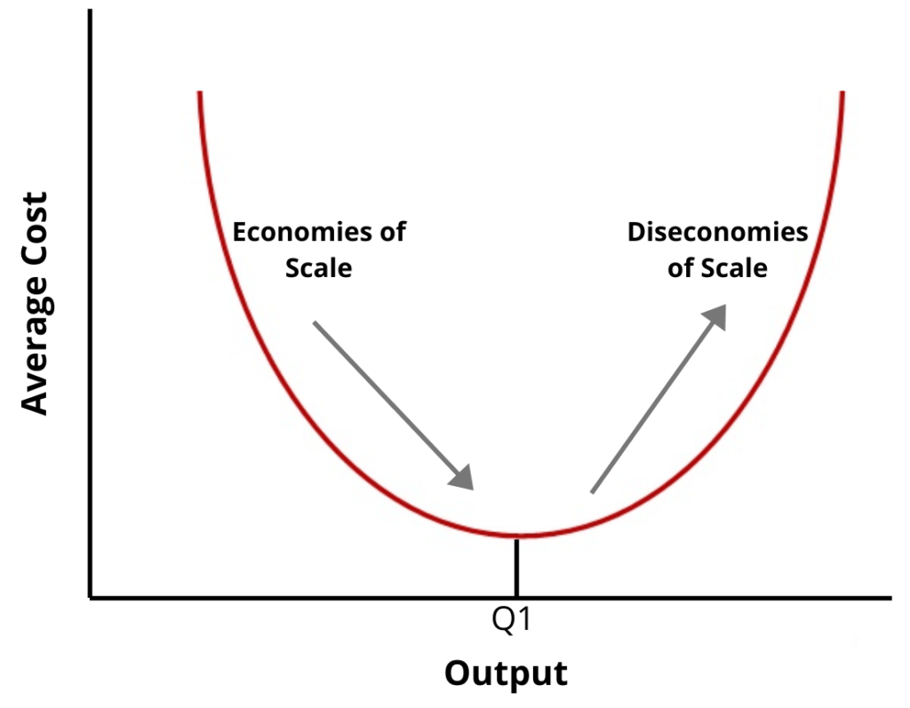

Slide 24
Examples of diseconomies include:
Larger firms often suffer poor communication because they find it difficult to maintain an effective flow of information between departments, divisions or between head office and subsidiaries. Time lags in the flow of information can also create problems in terms of the speed of response to changing market conditions. For example, a large supermarket chain may be less responsive to changing tastes and fashions than a much smaller, ‘local’ retailer.
Co-ordination problems also affect large firms with many departments and divisions, and may find it much harder to co-ordinate its operations than a smaller firm. For example, a small manufacturer can more easily co-ordinate the activities of its small number of staff than a large manufacturer employing tens of thousands.

Slide 25
‘X’ inefficiency is the loss of management efficiency that occurs when firms become large and operate in uncompetitive markets. Such loses of efficiency include over paying for resources, such as paying managers salaries higher than needed to secure their services, and excessive waste of resources. ‘X’ inefficiency means that average costs are higher than would be experienced by firms in more competitive markets.
Low motivation of workers in large firms is a potential diseconomy of scale that results in lower productivity, as measured by output per worker.
Large firms may experience inefficiencies related to the principal-agent problem. This problem is caused because the size and complexity of most large firms means that their owners often have to delegate decision making to appointed managers, which can lead to inefficiencies. For example, the owners of a large chain of clothes retailers will have to employ managers for each store, and delegate some of the jobs to managers but they may not necessarily make decisions in the best interest of the owners. For example, a store manager may employ the most attractive sales assistant rather than the most productive one.

Slide 26
Diseconomies of Scale
The disadvantages of large scale production that can lead to increasing average costs
Problems of management
Maintaining effective communication
Co-ordinating activities – often across the globe!
De-motivation and alienation of staff
Divorce of ownership and control

Slide 27
Diseconomies of Scale
There are limits to the amount a business can grow
If businesses grow to large they start to suffer from Diseconomies of Scale
These diseconomies happen because the larger the business the more difficult it becomes to manage

Slide 28
Some common diseconomies of scale:
Decision making
Managerial problems
Communication problems
Co-ordination/control problems
Staffing problems

